Slide 1




Slide 2

JOSEPHUS
PROBLEM

Slide 3

TEST TIME ON COMBINATION
URL: https://forms.gle/9e9Xk6RhCqE37aTZ8
QR CODE:

Slide 4
JOSEPHUS PROBLEM
Introduction
This problem goes back to Josephus Flavius, a 1st century Roman historian
41 rebels are trapped in a cave, surrounded by enemy troops.They decide to commit suicide: they line up in a circle and systematically kill every other one, going around and around, until only one rebel is left -- who supposedly kills himself (fat chance).

Slide 5
JOSEPHUS PROBLEM
Task
Given the total number of persons n and a number k which indicates that k-1 persons are skipped and kth person is killed in circle.
The task is to choose the place in the initial circle so that you are the last one remaining and so survive.

Slide 6
JOSEPHUS PROBLEM
Examples
n = 5 and k = 2
The safe position is 3. Firstly, the person at position 2 is killed, then person at position 4 is killed, then person at position 1 is killed. Finally, the person at position 5 is killed. So the person at position 3 survives
n = 7 and k = 3
The safe position is 4. The persons at positions 3, 6, 2, 7, 5, 1 are killed in order, and person at position 4 survives

Slide 7
JOSEPHUS PROBLEM
Thinking
Clearly, we can represent the rebels by a list of numbers {1,2,...,41} and we can simulate the demise of the corresponding rebel by manipulating this list.
For example, we could just mark the dead rebels by switching item i to -i (a standard hack, and a true abuse of negative numbers).
Actually, it will be more interesting to generalize slightly: let us deal with the problem for an arbitrary number n of rebels.
So, our original list is {1,2,...,n} , and we have to make a n-1 deletions in the right place to find the survivor.

Slide 8
JOSEPHUS PROBLEM
Structure
The problem has following recursive structure
josephus(n, k) = ( josephus(n - 1, k) + k-1 ) % n + 1
josephus(1, k) = 1
After the first person (kth from beginning) is killed, n-1 persons are left.
So we call josephus(n – 1, k) to get the position with n-1 persons.
But the position returned by josephus(n – 1, k) will consider the position starting from k%n + 1.
So, we must make adjustments to the position returned by josephus(n – 1, k).

Slide 9
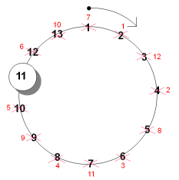
JOSEPHUS PROBLEM
Example
In the above image the execution starts from 2 and finally the free person will be 11.

Slide 10
JOSEPHUS PROBLEM
Program
josephus1.java
IO Format
Input
n = 14; k = 2
Output
13
Explanation
The chosen place is 13
Time Complexity
O(n)

Slide 11
JOSEPHUS PROBLEM
import java.io.*; class EthCOde { static int josephus(int n, int k) { if (n == 1) return 1; else /* The position returned by josephus(n - 1, k) is adjusted because the recursive call josephus(n - 1, k) considers the original position k%n + 1 as position 1 */ return (josephus(n - 1, k) + k - 1) % n + 1; } public static void main(String[] args) { int n = 14; int k = 2; System.out.println(josephus(n, k)); } }

Slide 12
JOSEPHUS PROBLEM
Another Solution
Let’s take an example of there are 5 people in a circle and execution starts clockwise at position 3
So there are five people – 1 2 3 4 5 and execution starts clockwise at position 3. Therefore if you kill 3 then are left with the list something like – 1 2 4 5.
Now again you have to kill the person at position 3 clockwise counting from the last killed person.

Slide 13
JOSEPHUS PROBLEM
Another Solution
Now you need to execute the person at position 1. So executing the person at 1 you are left with the list 2 4 5.
After executing another person you get list 2 4.
Now you are left with 2 persons in the list. So you have to calculate the position wisely to execute the person.
Therefore the calculated position would be
(starting position of the execution)%(no of people remaining in the list less than starting position)
i.e. 3%2 = 1.
So finally the winner is 4.

Slide 14
JOSEPHUS PROBLEM
Program
josephus2.java
IO Format
Input
n = 14; k = 2
Output
13
Explanation
The chosen place is 13
Time Complexity
O(n)

Slide 15
JOSEPHUS PROBLEM
import java.util.List; import java.util.stream.Collectors; import java.util.stream.IntStream; public class JosephProblem { public static void main(String[] args) { int winner = joseph(5, 3); System.out.println(winner); } public static int joseph(int noOfPeople, int remPosition) { int tempPos = remPosition - 1; int[] people = new int[noOfPeople]; for (int i = 0; i < noOfPeople; i++) { people[i] = i + 1; } int iteration = noOfPeople - 1; | List<Integer> list = IntStream.of(people).boxed().collect(Collectors.toList()); while (iteration > 0) { list.remove(tempPos); tempPos += remPosition - 1; if (tempPos > list.size() - 1) { tempPos = tempPos % list.size(); } iteration--; } return list.get(0); } }

Slide 16
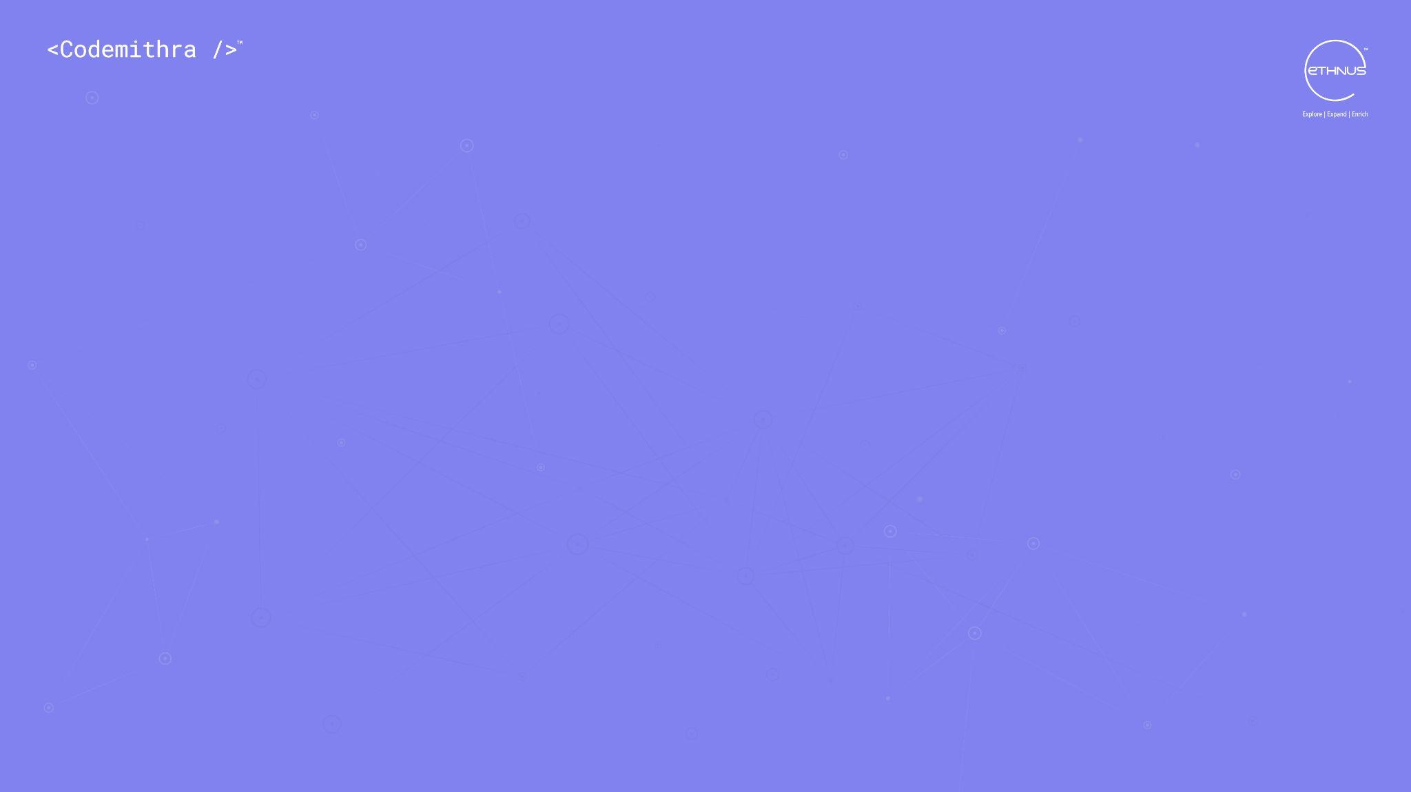



THANK YOU
+91 78150 95095
codemithra@ethnus.com
www.codemithra.com

